Slide 1
SPIRAL MODEL

Slide 2
Introduction
The spiral model, also known as the spiral lifecycle model.
This model of development combines the features of the prototyping model and the waterfall model.
Each phase starts with a design goal and ends with the client (who may be internal) reviewing the progress thus far.
Analysis and engineering efforts are applied at each phase of the project, with an eye toward the end goal of the project.

Slide 3
History Of Spiral model
Defined by Barry Boehm in his 1986 article "A Spiral Model of Software Development and Enhancement“
As originally envisioned, the iterations were typically 6 months to 2 years long.
Notes:
These early papers use the term "process model" to refer to the spiral model as well as to incremental, waterfall, prototyping, and other approaches. However, the spiral model's characteristic risk-driven blending of other process models' features is already present
R]isk-driven subsetting of the spiral model steps allows the model to accommodate any appropriate mixture of a specification-oriented, prototype-oriented, simulation-oriented, automatic transformation-oriented, or other approach to software development

Slide 4
WHAT IS SPIRAL MODEL?
The spiral model has four phases: Planning, Risk Analysis, Engineering and Evaluation.
Software project repeatedly passes through these four phases in iterations (called Spirals).
The baseline spiral, starting in the planning phase, requirements are gathered and risk is assessed. Each subsequent spirals builds on the baseline spiral.

Slide 5
Spiral model is meta model?
Spiral model is also called as meta-model because in a way it comprises of other models of SDLC.
Both waterfall and prototype models are used in it.
Here we do software development systematically over the loops (adhering to waterfall approach) and at the same time we make a prototype and show it to user after completion of various phase (just in case of prototype model).
This way we are able to reduce risks as well as follow systematic approach
Notes:
The systems development life cycle (SDLC).

Slide 6
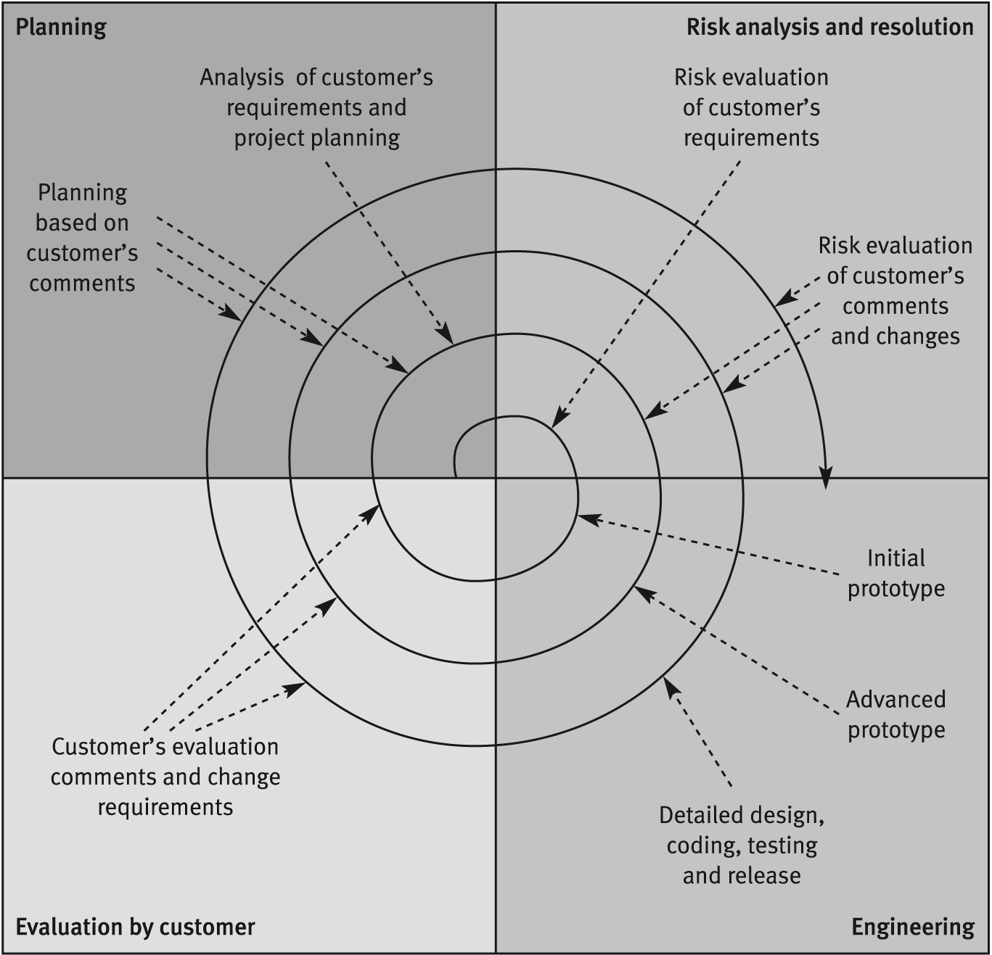
The Spiral Model
Can see each spiral
includes:
Planning
Risk Analysis / Resolution
Engineering activities
(design, code, test…)
Customer Evaluation
(errors, changes, new
requirements…)

Slide 7
PHASES OF SPIRAL MODEL
A spiral model has 4 phases described below:
Planning phase
Risk analysis phase
Engineering phase
Evaluation phase.

Slide 8
PLANNING
Requirements are studied and gathered.
Feasibility study
Reviews and walkthroughs to streamline the requirements
Requirements understanding document
Finalized list of requirements.
The project is reviewed and a decision made whether to continue with a further loop of the spiral.
If it is decided to continue, plans are drawn up for the next phase of the project.

Slide 9
RISK ANALYSIS
Requirements are studied and brain storming sessions are done to identify the potential risks
Once the risks are identified , risk mitigation strategy is planned and finalized
Document which highlights all the risks and its mitigation plans

Slide 10
ENGINEERING
Actual development and testing for the software takes place in this phase
Code
Test cases and test results
Test summary report and defect report.

Slide 11
EVALUATION
Customers evaluate the software and provide their feedback and approval
Features implemented document

Slide 12
When to Use Spiral model?
When the project is large.
Where the software needs continuous risk evaluation.
Requirements are a bit complicated and require continuous clarification.
Software requires significant changes.
Where enough time frame is their to get end user feedback.
Where releases are required to be frequent.
Users are unsure of their needs.

Slide 13
Advantages
Development is fast
Larger projects / software are created and handled in a strategic way
Risk evaluation is proper.
Control towards all the phases of development.
More and more features are added in a systematic way.
Software is produced early.
Has room for customer feedback and the changes are implemented faster.
Risk reduction mechanisms are in place.
Supports iteration and reflects real-world practices –Systematic approach

Slide 14
Disadvantages
Risk analysis is important phase so requires expert people.
Is not beneficial for smaller projects.
Spiral may go infinitely.
Documentation is more as it has intermediate phases.
Complex, relatively difficult to follow strictly.
Applicable only to large systems
It is costly for smaller projects.

Slide 15
Comparison
Spiral Model
Waterfall model
Risk factors are considered.
The requirements are not freeze.
works in loop.
costly as Risk factor is covered.
Better communication between developer and customer.
Risk factors are not considered.
The requirements are freeze.
Is linear sequential model.
Not much costly.
Communication level is not high

Slide 16
Comparison
Spiral Model
prototype model
Number of phases is not fixed.
Used when requirement is not clear and needs conformation
customer interaction continuous to move together.
Risk factor is considered
Number of phases is fixed.
Requirement are clear but complex.
Customer interaction needs till the prototype is perfect.
Risk factor are not considered

Slide 17
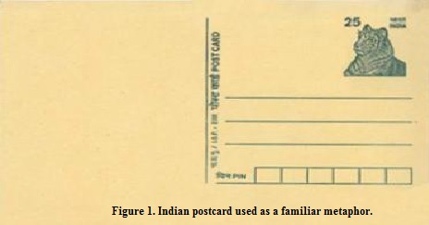
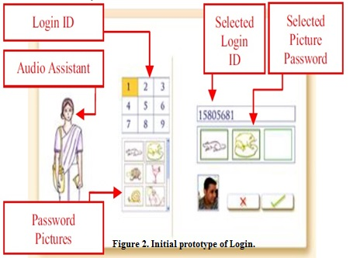
Examples
In 2010 with the collaboration of Microsoft Research ,Bangalore, India and University of Toronto Canada made a project with spiral model “Exploring the Feasibility of Video Mail for Illiterate Users”

Slide 18
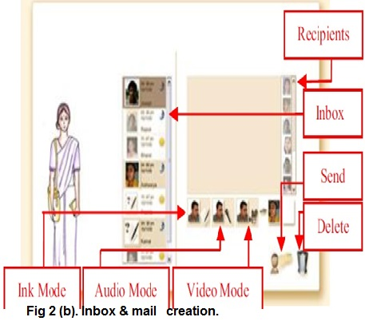
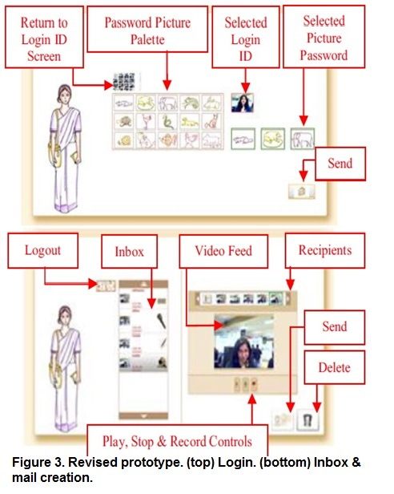
Video Mail for Illiterate Users

Slide 19
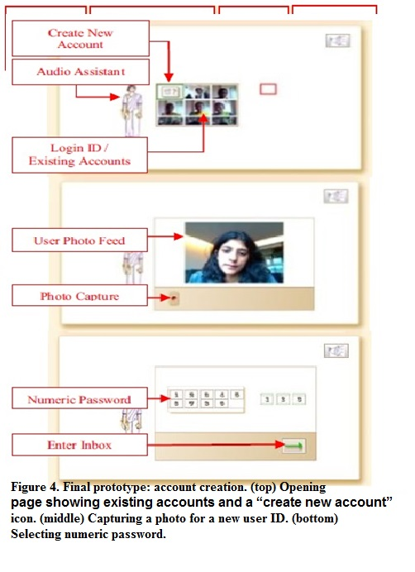
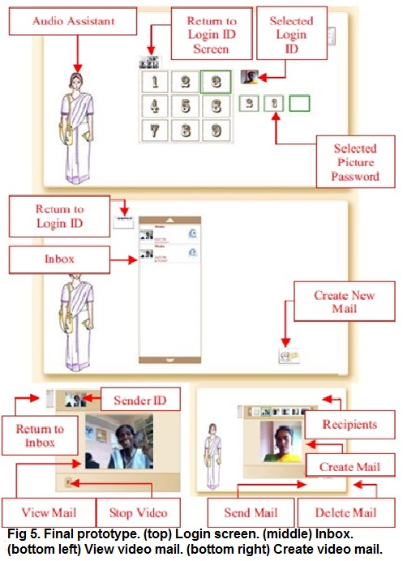
Video Mail for Illiterate Users

Slide 20
Conclusion
Each spiral can be termed as a loop and each loop is a separate development process in a spiral model.
The four activities (Planning, Risk analysis, engineering and evaluation) form the intermediary phases of a spiral model and is repeated again for each loop.
This model is very good to use for larger projects where you can develop and deliver smaller prototypes and can enhance it to make the larger software.
The implementation of this model requires experienced resources as risk analysis is a very integral part of this model and risk analysis requires expertise and as a result this model becomes costly.

Slide 21
References
What is spiral model and when to use
http://www.softwaretestinghelp.com/spiral-model-what-is-sdlc-spiral-model/
Advantages and dis advantages
http://www.technotrice.com/what-is-spiral-model-software-engineering/
http://dl.acm.org/citation.cfm?id=45801
Introduction , history
http://en.wikipedia.org/wiki/Spiral_model
http://robincse.blogspot.com/2012/03/boehms-spiral-process-model.html
Example
http://www.dgp.toronto.edu/~ravin/papers
Video mail system for illiterate users

